Slide 1
TASK 2
Created By : Sakshi Shishir Chandanshive

Slide 2
Netsparker
Vulnerabilities and report of netsparker

Slide 3
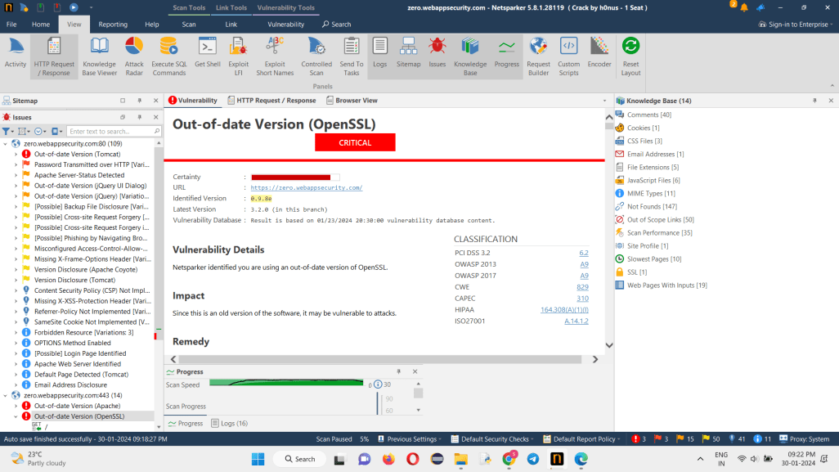

Slide 4
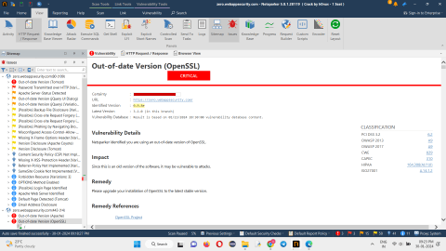
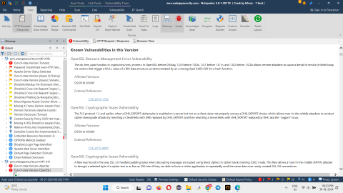
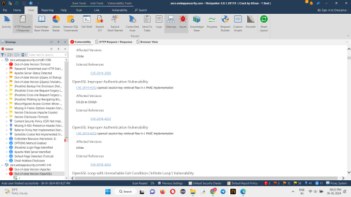
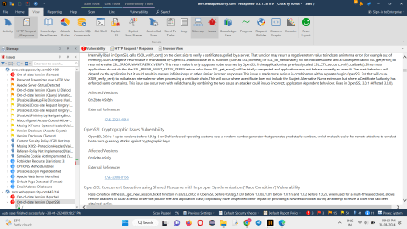

Slide 5
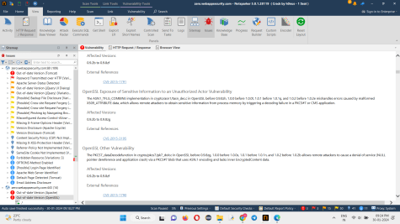
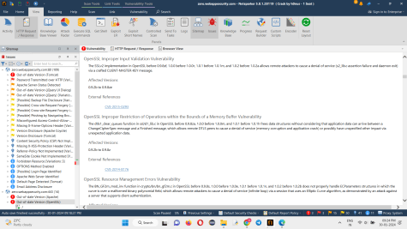
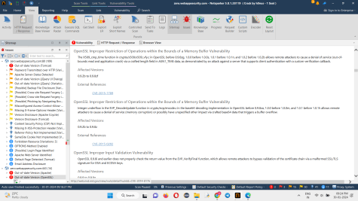
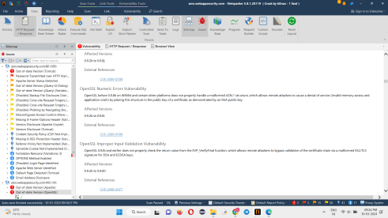

Slide 6
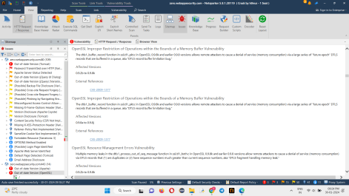
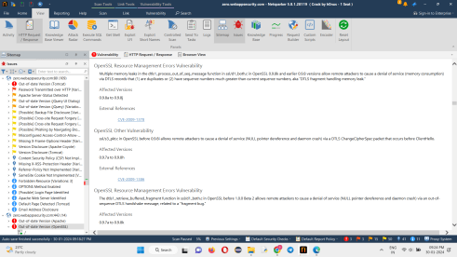
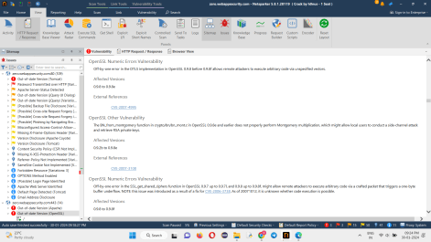
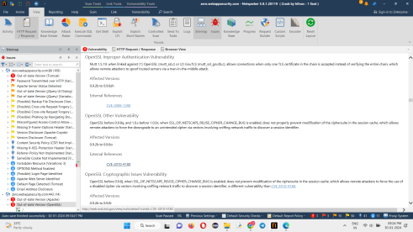

Slide 7
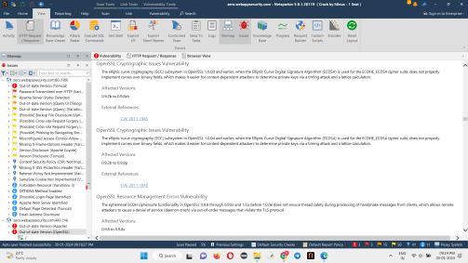
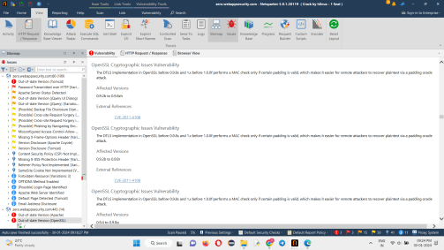

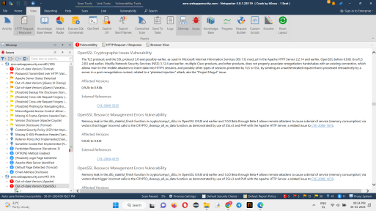

Slide 8
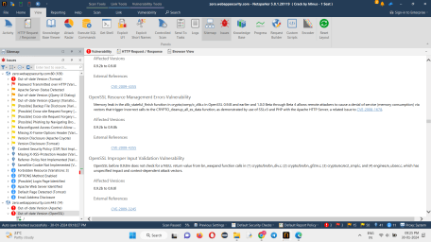
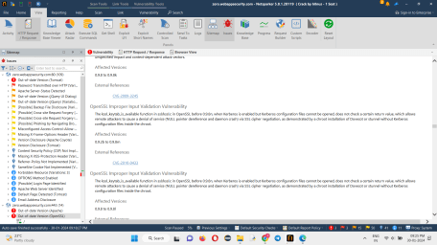
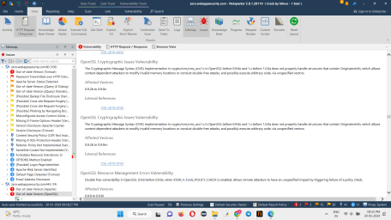
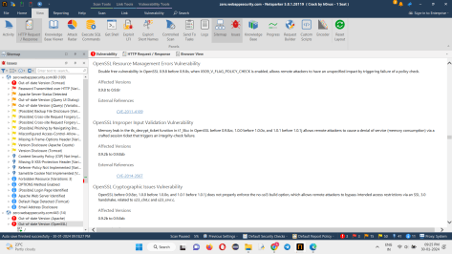

Slide 9
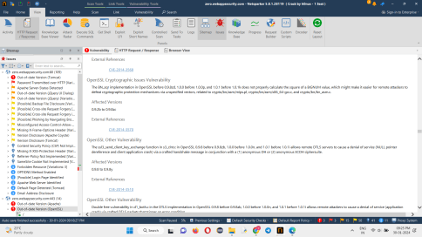
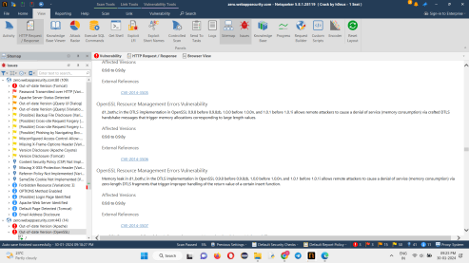
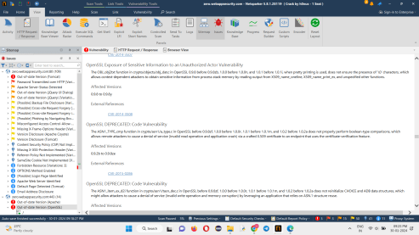
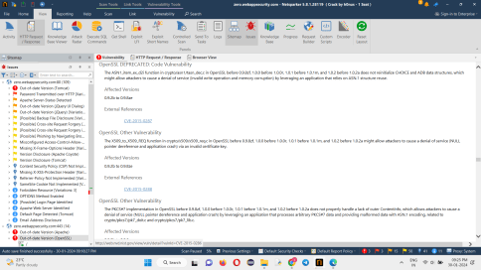

Slide 10
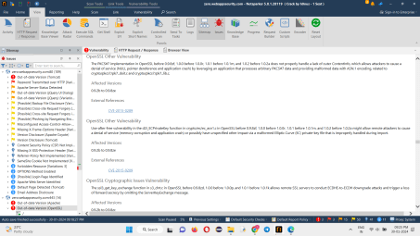
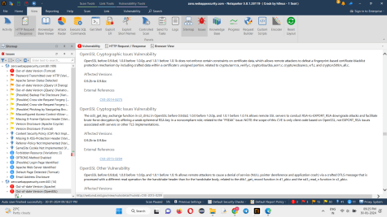
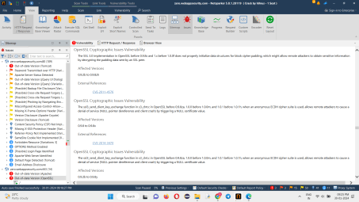
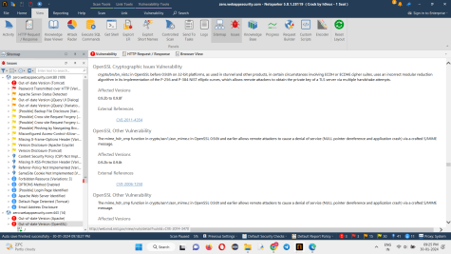

Slide 11
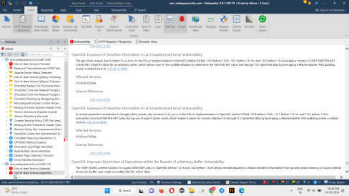
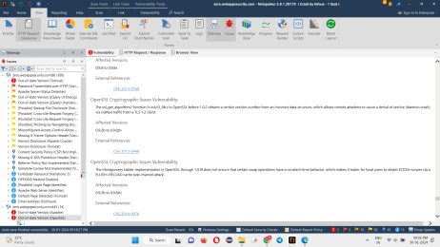
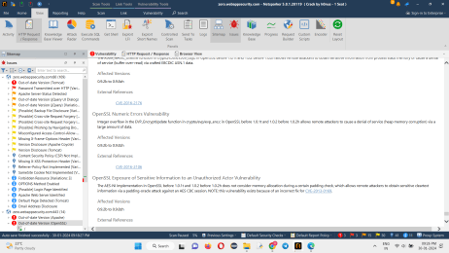
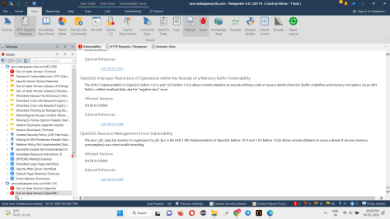

Slide 12
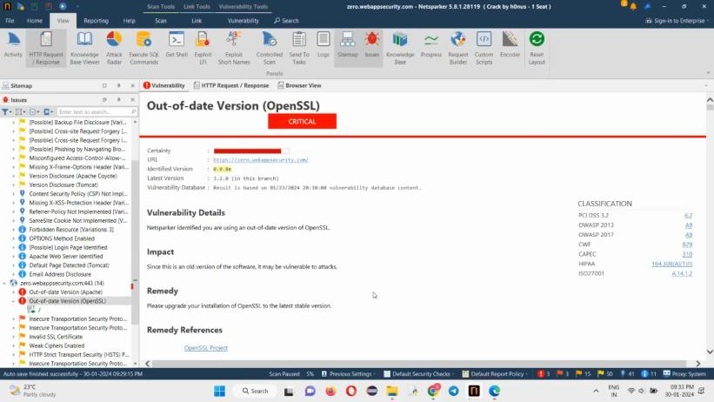
Video of Netsparker Report :

Slide 13
Report :
Title : Out-of-date Version (OpenSSL)
Certainty : Critical
Domain : https://webappsecurity.com/
Sub-domain : https://zero.webappsecurity.com/
Identified Version : 0.9.8e
Latest Version : 3.2.0 (in this branch)
Vulnerability Database : Result is based on 01/23/2024 20:30:00 vulnerability database content.
Impact : Since this is an old version of the software, it is vulnerable to many attacks which can cause data loss, denial of service and also company's data can be stolen.

Slide 14
Known Vulnerabilities in this Version :
OpenSSL Resource Management Errors Vulnerability: 0.9.2b to 0.9.8zf are the affected versions that allows remote attackers to cause a denial of service (infinite loop) via vectors that trigger a NULL value of a BIO data structure.
OpenSSL Cryptographic Issues Vulnerability : 0.9.2b to 0.9.8zh are the affected versions which allows man-in-the-middle attackers to conduct cipher-downgrade attacks by rewriting a ClientHello with DHE replaced by DHE_EXPORT and then rewriting a ServerHello with DHE_EXPORT replaced by DHE.
OpenSSL Improper Authentication Vulnerability : 0.9.2b to 0.9.8zh and 0.9.8e are the affected versions where there is a session retrieval flaw in J-PAKE implementation.
OpenSSL Cryptographic Issues Vulnerability : OpenSSL 0.9.8c-1 up to versions before 0.9.8g-9 on Debian-based operating systems uses a random number generator that generates predictable numbers, which makes it easier for remote attackers to conduct brute force guessing attacks against cryptographic keys.

Slide 15
OpenSSL Concurrent Execution using Shared Resource with Improper Synchronization ('Race Condition') Vulnerability : 0.9.2b to 0.9.8zf are the affected version when used for multi-threaded client, allows remote attackers to cause a denial of service (double free and application crash) or possibly have unspecified other impact by providing a NewSessionTicket during an attempt to reuse a ticket that had been obtained earlier
OpenSSL Exposure of Sensitive Information to an Unauthorized Actor Vulnerability : Due to errors caused by malformed X509_ATTRIBUTE data, which allows remote attackers to obtain sensitive information from process memory by triggering a decoding failure in a PKCS#7 or CMS application. Affected versions are 0.9.2b to 0.9.8zg.
OpenSSL Numeric Errors Vulnerability : 0.9.2b to 0.9.8j and 0.9.2b to 0.9.8i are the affected versions which allows remote attackers to cause a denial of service (invalid memory access and application crash) by placing this structure in the public key of a certificate, as demonstrated by an RSA public key on WIN64 and certain other platforms.

Slide 16
OpenSSL Resource Management Errors Vulnerability : 0.9.2b to 0.9.8k and 0.9.8a to 0.9.8j are the affected versions allow remote attackers to cause a denial of service (memory consumption) due to memory leaks in the dtls1_process_out_of_seq_message function in ssl/d1_both.c
Mitigation : If you want to prevent your website from vulnerabilities listed above please upgrade your installation of OpenSSL to the latest stable version.

Slide 17
Thank You

